Slide 1
Microservices and DevOps
DevOps and Container Technology
Security 101 – The Big Picture
Henrik Bærbak Christensen

Slide 2
Security is so important…
… that I have completely ignored it in all my courses ☺
Why?
You need a system in order to secure it
MSDO is about ‘crafting the system’ – so it ‘happens before’
Security is a quality attribute in conflict with all others I teach
Modifiability – loose coupling Security is tight coupling
Availability – allow access always Security is the opposite
Performance Security …
Etc
And … I have never dug deep into it ☺

Slide 3
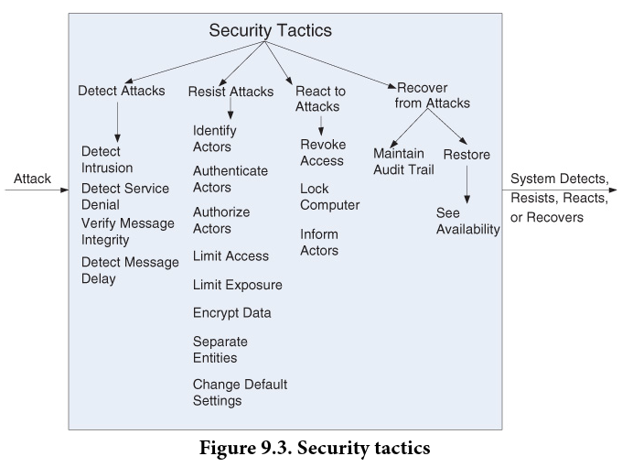
Security
According to Bass et al. Software Architecture in Practice
Concerned with ability to protect data and information from unauthorized access while still providing access to people/systems that are authorized
Lots of tactics

Slide 4
Disclaimer
I am no expert…
Only worked on it since Spring 2021 to be frank
Not a core practice when teaching and prototyping with no real data
MSDO take on the vast subject area is… limited…
Pedagogical point
You have to be able to construct a system in order to have something to protect
MSDO is about constructing that system…

Slide 5
Our Focus is Resisting
Authorize Actors
Encrypt Data
Limit Access

Slide 6
… Using Standard Tech
Security is one of the places in which you do not want to invent or code your own thing…
As you will get it wrong!
(Even standard things like SSL etc., get it wrong…)
Authentication and Authorization
We will look at OAuth 2.0
Encryption
We will look at encryption, TLS, HTTPS
Limit Access
We will look at key handling and least privileged principle

Slide 7
Note: They are Disjoint
You can
Encrypt data but allow access to everyone (no authentication)
Authorize only real users but not encrypt data
Only together do we achieve some level of security…
But… In practice
The OAuth protocol works excellent over insecure HTTP
Yeah, you send passwords on public network in clear text ☹
… But from a learning perspective, it works
Secure transmission, HTTPS, is cumbersome…
Hard couplings and key management …

Slide 8
So in MSDO…
We actually start in the “wrong end”
Authorization using OAuth 2.0 protocol first
(or rather, an adaption of it…)
Encryption using TSL later

